Slide 1


Optimisation
Part 2 – Computation

Slide 2


Coding
Optimisations

Slide 3
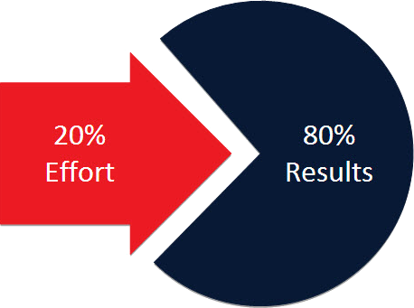
Speed Up the Common Path
The 80-20 rule has many applications to software development, e.g. about 80% of CPU time will be spent in about 20% of the functions, etc.
Whilst the actual percentage values are irrelevant – the notions of a common path of execution and the existence of performance bottlenecks is very relevant.
Notes:
The 80-20 rule has many applications to software development. For example, about 80% of a typical use case will traverse only about 20% of the source code, and about 80% of the CPU time will be spent in about 20% of the functions.
The actual percentage values are irrelevant –the notions of the common path of execution and the existence of performance bottlenecks is very relevant.

Slide 4

Redundant Computations and Caching

Slide 5

Consider:
1 | for (i = 0; i < 100; i++) {
2 | a[i] = m*n;
3 | }
m*n is computed every iteration and should be moved outside of the loop (routinely done by a decent optimising compiler).
More problematically:
1 | for (... ;!done;... ) {
2 | result = someFunction(arg1,
3 | functionThatReturnsAFixedValue());
4 | }
Both are examples of recomputing something that is already known.
The compiler may not be able to determine that the returned value will not change.
Notes:
Consider:
for (i = 0; i < 100; i++) {
a[i] = m*n;
}
m*n is computed every iteration and should be moved outside of the loop to avoid redundant computation (routinely done by a decent optimising compiler)
As another example:
for(... ;!done;... ) {
result = someFunction(arg1, someFunctionThatWillReturnAFixedValue());
}
Here it may not be so easy for the compiler to identify that the returned argument will not change across the loop.
Both are examples of recomputing something that we already know.

Slide 6
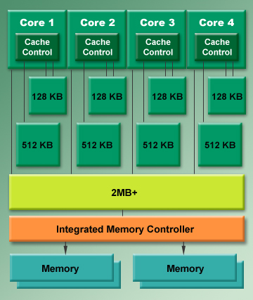
Caching is about keeping the results of frequent and/or costly computations readily accessible so that the data can be readily used.
Assuming memory size is not an issue and execution speed is to be optimised then cache as much as possible
Notes:
Consider:
for (i = 0; i < 100; i++) {
a[i] = m*n;
}
m*n is computed every iteration and should be moved outside of the loop to avoid redundant computation (routinely done by a decent optimising compiler)
As another example:
for(... ;!done;... ) {
result = someFunction(arg1, someFunctionThatWillReturnAFixedValue());
}
Here it may not be so easy for the compiler to identify that the returned argument will not change across the loop.
Both are example of are recomputing something we already that we already know.

Slide 7
Caching typically provides big performance gains for:
Disk access
Mathematical operations
Object allocation
Thread creation.
Where possible, only open and read a file once. Cache the contents if they will be frequently used.
Many are computationally expensive (sometimes deceptively so, e.g pow(x,y)).
For short lived objects allocation and deallocation can consume more cycles that whatever useful functionality is performed by that object.
Thread creation and destruction introduces an overhead. Frequent and short-lived threads should make use of a thread pool.
Notes:
Consider:
for (i = 0; i < 100; i++) {
a[i] = m*n;
}
m*n is computed every iteration and should be moved outside of the loop to avoid redundant computation (routinely done by a decent optimising compiler)
As another example:
for(... ;!done;... ) {
result = someFunction(arg1, someFunctionThatWillReturnAFixedValue());
}
Here it may not be so easy for the compiler to identify that the returned argument will not change across the loop.
Both are example of are recomputing something we already that we already know.

Slide 8
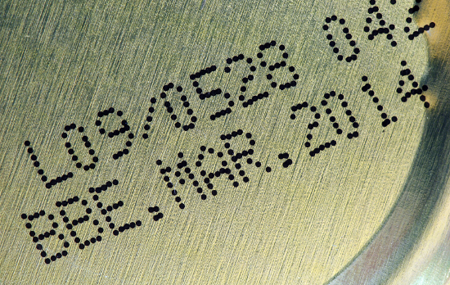
Cache Invalidation
Cache invalidation arises when the stored cache value and the original datum value differ (in which case the cache value should either be ejected or refreshed).
Two common approaches to handle this are:
Use a callback mechanism to notify the cache of data change.
Use a maximum lifetime value for stored data to eject/refresh data.
Notes:
A cache holds a copy of some data. If there is any possibility that the original datum might change then the possibility of cache invalidation arises where the cached value and the original value now differ.
In which circumstance, some means of detecting ad recovering from cache invalidation is needed (either remove the value from the cache, or repopulate the cache).
One approach is to require that the cache data uses a callback mechanism, whereby any changes in the underlying data issues a notification, through the callback, to inform the cache. Alternatively, data in the cache may have a defined lifetime, beyond which the value is refreshed/discarded.

Slide 9
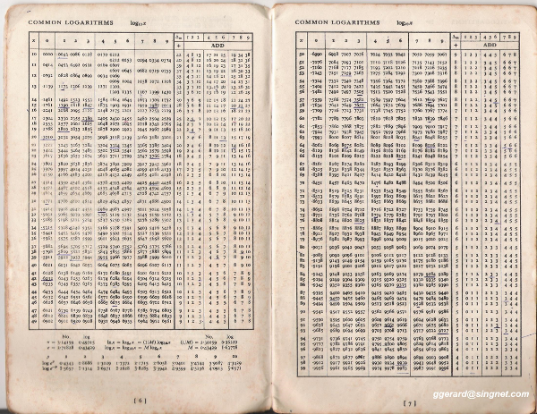
Precompute
Precomputation is similar to caching except that the values are calculated at some earlier point in time (during initialisation, or as part of the compile process, etc.).
It is used frequently within games development (e.g. baking lights, etc.)
Notes:
Precomputation is similar to caching with the exception that the values are calculated at some earlier point in time (e.g. during program initialisation, or as part of the compilation process or an earlier run).
It is used frequently within games development (e.g. baking lights, etc.)

Slide 10

Lazy Evaluation

Slide 11
1 | void sendMessage(const std::string& message)
2 | {
3 | std::string errorMsg; // string always created
4
5 | // Likely the message is 99% sent without error
6 | switch( trySendMessage(message) )
7 | {
8 | case -1:
9 | errorMsg = "Connection not established";
10 | logError(errorMsg); break;
11 | case 10:
12 | errorMsg = "Message rejected";
13 | logError(errorMsg); break;
14 | }
15 | } // string always destructed
Lazy evaluation entails that you defer computations until they are actually needed.
This helps remove problems where a set of costly computations may not be needed (i.e. they should not be performed just in case).
Better to embed/create the string when it is needed
1 | logError(std::string("Connection not established"));
2 | logError(std::string(“Message rejected"));
Notes:
Lazy evaluation entails that you defer computations until they are actually needed.
This helps remove problems where a set of costly computations may not be needed (i.e. they should not be performed just in case).

Slide 12

1 | void foo()
2 | {
3 | std::string m; // Default constructor
4 | // …
5 | char *c = “Message";
6 | // …
7 | m = c; // Implicit conversion + assignment
8 | }
Where possible, object creation should be deferred until all elements needed to construct the class have been obtained (to avoid needless construction costs).
This code is better implemented using single -step construction as:
1 | void foo()
2 | {
3 | char *c = “Message";
4 | std::string m(c); //Paramterised constructor
5 | }
Notes:
Where possible, object creation should be deferred until all elements needed to construct the class have been obtained (to avoid needless construction costs).
void foo()
{
std::string m; // Default constructor
//...
char *c = "Message";
//...
m = c; // Implicit conversion + assignment
//...
}
This code is better implemented using single -step construction as:
void foo()
{
char *c = "Message";
std::string m(c); // One-step construction
//...
}

Slide 13

Useless
Computation
Lazy evaluation is about removing computations that are not always necessary.
Useless computation is anything that is never necessary.
Eliminate any such code with extreme prejudice.
Notes:
Lazy Evaluation is about removing computations that are not always necessary. Useless computations are about those computations that are never necessary. Eliminate any such code with extreme prejudice.

Slide 14

Evaluation Order

Slide 15
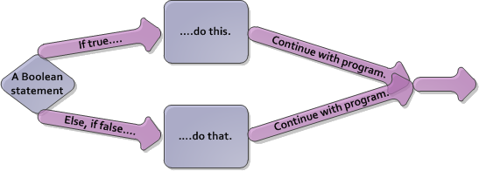
Where conditional expressions consist of several logically combined sub-expressions it is important to consider the evaluation order.
Consider:
1 | if(e1 || e2) {...}
1 | if(e1 && e2) {...}
If e1 evaluates to true, consideration stops. If e1 evaluates to false, then e2 is evaluated.
If e1 evaluates to false, consideration stops. If e1 evaluates to true, then e2 is evaluated.
Notes:
Where conditional expressions consist of several logically combined subexpressions the evaluation order is important to consider. Consider:
if (e1 || e2) {...}
// If e1 evaluates to true, consideration stops. If e1 evaluates to false, then e2 is evaluated.
if (e1 && e2) {...}
// If e1 evaluates to false, consideration stops. If e1 evaluates to true, then e2 is evaluated.

Slide 16

Which comes first depends upon the evaluative cost of both and the probability that it will evaluate to true.
1 | if(e1 || e2) {...}
1 | if(e1 && e2) {...}
If e1 and e2 are equally likely to be true, then the one with smallest computational cost should be first.
If e1 and e2 are of equal computational cost, then the one most likely to be true should be first.
If e1 and e2 are equally likely to be false, then the one with smallest computational cost should be first.
If e1 and e2 are of equal computational cost, then the one most likely to be false should be first.
Notes:
Which comes first depends upon the evaluative cost of both and the probability that it will evaluate to true.
For OR
If e1 and e2 are equally likely to evaluate to TRUE, then the subexpression with the smaller
computational cost should be placed first in the evaluation order. If, on the other hand, e1 and e2 are of
equal computational cost, then the one most likely to evaluate to TRUE should appear first.
For AND
If e1 and e2 are equally likely to evaluate to FALSE, then the subexpression with the smaller
computational cost should be placed first in the evaluation order. If, on the other hand, e1 and e2 are of
equal computational cost, then the one most likely to evaluate to FALSE should appear first.

Slide 17

Key takeaways:
Do you need the results now? Defer a computation to when it is actually needed.
Do you know the result already? If you computed it earlier then make it available for reuse.
Speed up the processing of the common path even if it is at the expense of other paths.

